Slide 1




AtliQ Hardwares
Consumer Goods Ad-Hoc Insights
Made by – Protyoy Pritam Goswami

Slide 2

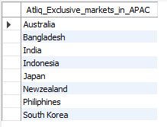
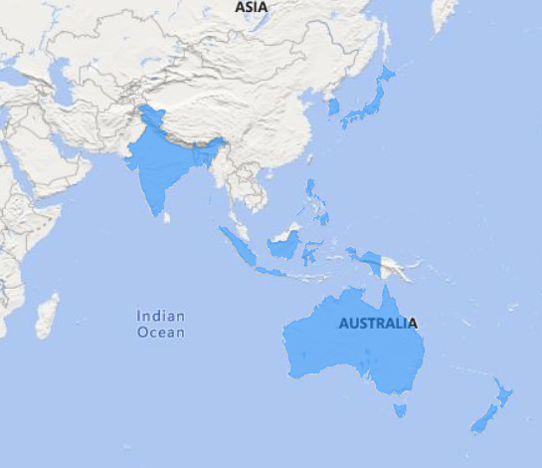
Insight #1 Atliq Exclusive markets in APAC region

Slide 3

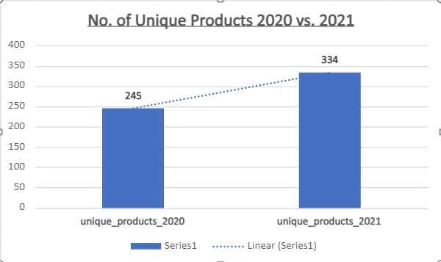
Insight #2 %age Change in Unique Products in F.Y.-2021 vs F.Y.-2020
There is a 36.33% increase in unique products in f.y. 2021 vs f.y. 2020 from 245 to 334.

Slide 4
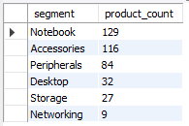
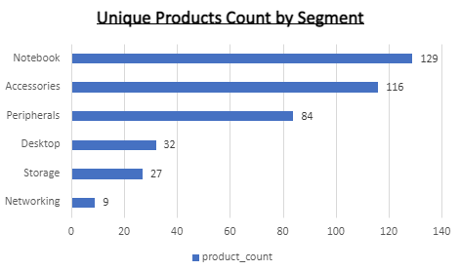
Insight #3 Unique Products by Segment
Notebook segment has the most unique products counting to 129 followed by Accessories(116) and Peripherals(84).

Slide 5
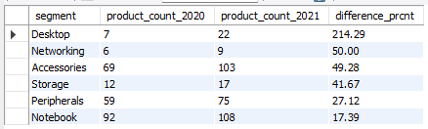
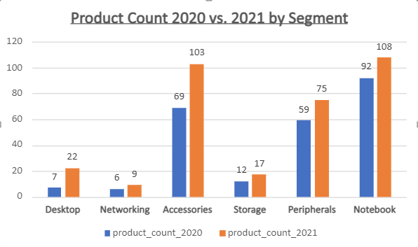
Insight #4 Segment wise Product Count by Year
Notebook segment has the most unique products counting to 92 and 108 in f.y. 2020 and f.y. 2021 respectively. Accessories segment (69 and 103) and Peripherals segment(59 and 75) follows.
However the highest increase in unique products count can be seen in Desktop segment followed by Networking and Accessories segment.

Slide 6

Insight #5 Highest and Lowest Manufacturing Cost Products

Slide 7
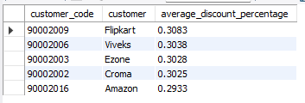
Insight #6 Customers Having Average High Pre-Invoice Discount in 2021
In F.Y. 2021, Flipkart had the highest pre invoice discount(0.3083%) followed by Viveks(0.3038%) and Ezone(0.3028%).

Slide 8
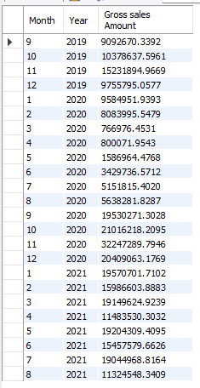
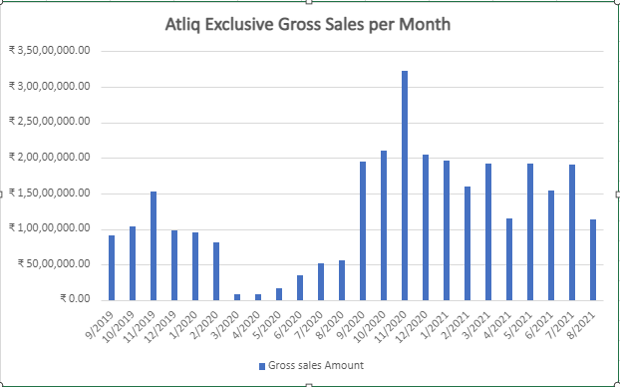
Insight #7 Gross Sales to Atliq Executive by Month
The Gross Sales amount for customer 'Atliq Exclusive' was highest in November '20 (₹32.25 Mn.) followed by October '20 (₹21.02 Mn.) and December '20 (₹20.41 Mn.)

Slide 9
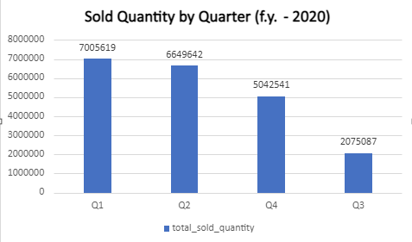

Insight #8 Total Sold Quantity by Quarter in F.Y. - 2020
Total Sold Quantity was highest in Q1 (7005619) and lowest in Q3 (2075087) in F.Y. - 2020

Slide 10
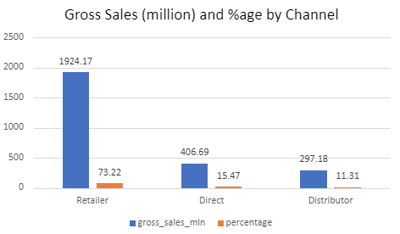

Insight #9 Gross Sales by Channel in F.Y. - 2021
In F.Y. - 2021, Retailer channel brought the highest sales (₹1924.17 Mn.) while Distributor brought the lowest sales (₹297.18 Mn.). They both add up to 73.22% and 11.31% of Net Gross Sales respectively.

Slide 11
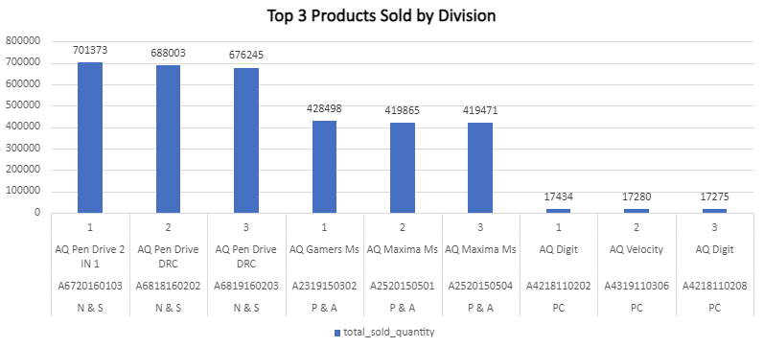
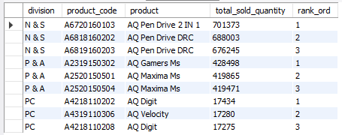
Insight #10 Gross Sales by Channel in F.Y. - 2021

Slide 12
Thank You...

